Slide 1
Analysis of water resources management in the Western Balkan region Identification
Of Kosovo* national issues
Related to WRM
Jelena Đokić
University of Priština in Kosovska Mitrovica
Workshop on innovative practices in the EU water sector: barriers and opportunities/ 8th to10thMay 2019
Vienna
This project has been funded with support from the European Commission. This publication reflects the views only of the author, and the Commission cannot be held responsible for any use which may be made of the information contained therein.

Slide 2
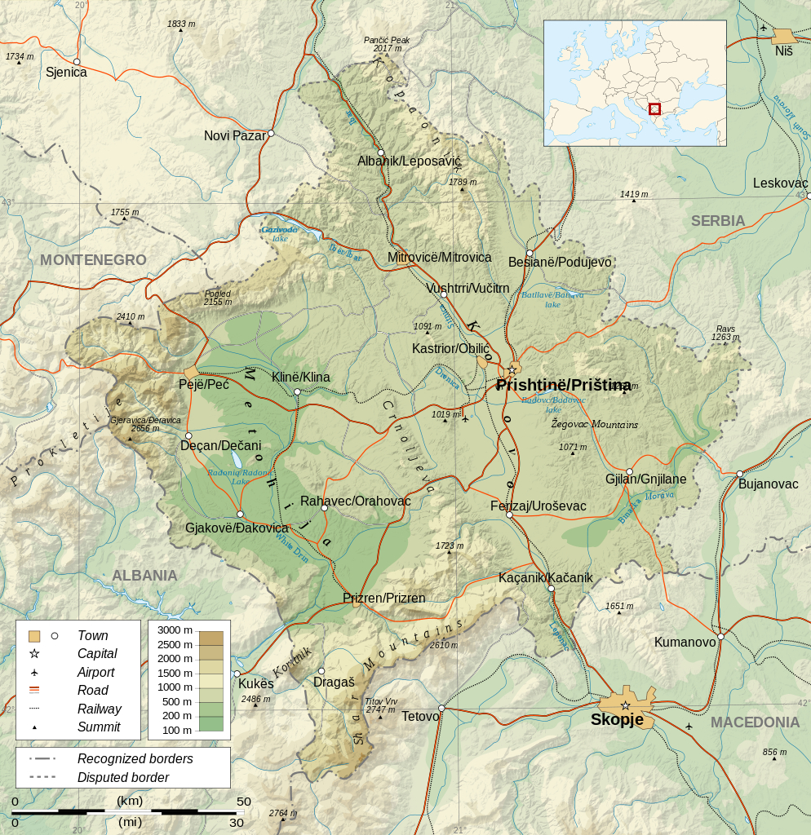
Geography of Kosovo*
Kosovo and Metohija is autonomous provinces of Serbia under the interim UN administration in accordance with the United Nations Security Council Resolution 1244/99, in further as Kosovo*. It is surrounded by: Albania (length of the border - 112 km), Macedonia (161 km), Serbia (352 km) and Montenegro (77 km).
N 41° 50' 58'' to 43° 15' 42'‘
E 20° 01’ 02'' to 21° 48’ 02’’. Surface10,907 km²
population of 1.74 million inhabitants 1,739,825 residents, excluding municipalities: Leposavić, Zubin Potok, Zvečan and Mitrovica North (160 inhabitants per km²).
Strengthening of master curricula in water resources management
for the Western Balkans HEIs and stakeholders
www.swarm.ni.ac.rs

Slide 3
Geography of Kosovo*
surrounded by high mountains, (Prokletije, Šar planina, Kopaonik and Central Mountains) peaks exceeding 2,000 m above sea level (highest peak - Đeravica 2,656mtwo great plains in the middle, Metohija and Kosovo.
hydrographic key, towards the Adriatic, the Black Sea and Aegean Sea.
Agricultural land makes up 53 % of the territory and forests make up 39.1 % of the territory, whereby approximately half (52.3 %) of the land is arable, while one third (31 %) are pastures (UNDP).
characterized by continental climate. Amplitude -20C º in winter to +38 º C in summer and annual average rainfall of 700 mm.
Industry is in transition. Such economic traits have resulted with the domination of rural population over the urban one.
Strengthening of master curricula in water resources management
for the Western Balkans HEIs and stakeholders
www.swarm.ni.ac.rs

Slide 4
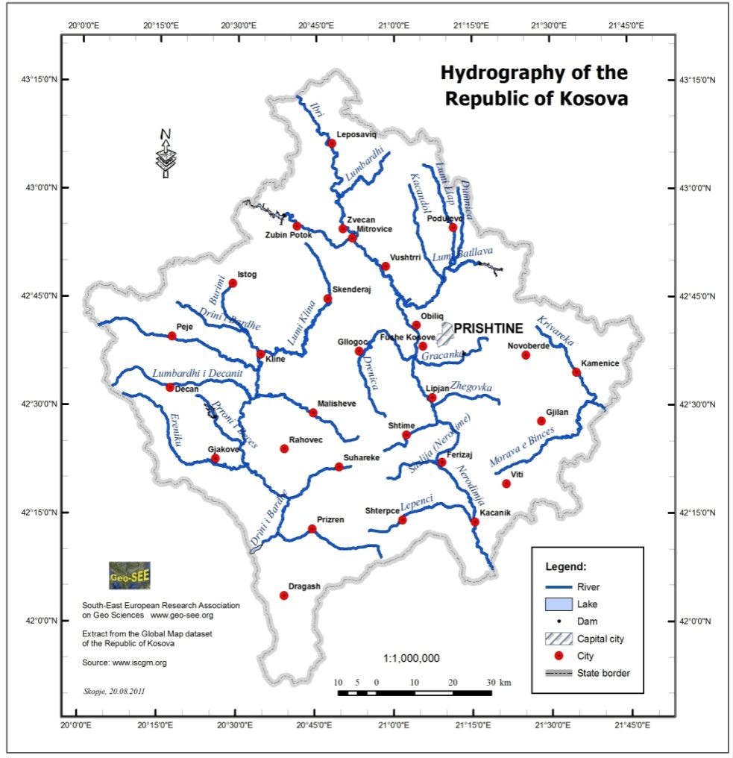
Water resources in Kosovo*
Hydrographic map of Kosovo*
underground and thermal water.
Surface water resources are significant on the territory of Kosovo*
All rivers in Kosovo* can be divided into drainage basins of three seas: Black Sea (the largest area – 5500 km²) or 51% of the Kosovo* territory, Adriatic Sea (4.500 km²) or 43%, and Aegean Sea (900 km²) or just 6%.
hydrographic knot where there is a diversion between the basins of the Black, the Adriatic and the Aegean seas.
From the highest point of Crnoljevo the Topluga river goes west in to the Beli Drim and onwards to the Adriatic Sea. To the north, Crnoljeva river descends, which through Sitnica and Ibar goes to the Black Sea. To the south flows Nerodimka, tributary to Lepenac, which through Vardar sends water to the Aegean Sea.
Strengthening of master curricula in water resources management
for the Western Balkans HEIs and stakeholders
www.swarm.ni.ac.rs

Slide 5
Water resources in Kosovo*
Lakes of Kosovo*
Regarding the rivers, the hydrography of water flows of Kosovo* is split into five river basins: Beli Drim (Adriatic Sea basin), Ibar (Black Sea basin), Lepenac (Aegean Sea), Binačka Morava (Black Sea basin), Plava River (Adriatic Sea).
Natural lakes :Lake Sava on Prokletije. There are 12 Glacial Lakes on mount Šar, and the most famous are: Šutmansko (2070m n. V.), Golemo (2400m n. V.) and Livadičko Lake. It is located at an altitude of 2173 m, and although it does not have a large surface (about 21000 m²), it is the deepest glacial lake in Kosovo*.
The largest artificial lakes are located on the periphery of the Kosovo Basin, and are made primarily for irrigation. The lake of Batlava, is located on the river Lab. It is used for the water supply of Kosovska Mitrovica and Priština, as well as hydroelectric power station. Lake Gazivode, formed by the damming of the Ibar river in the upper stream, is 24 km long, and the height of the dam is 107 m. The dam is built of natural materials, and as such is one of the largest in Europe. The main purpose of Gazivode Lake is irrigation of the Kosovo* lowland, supply of drinking water to the Kosovska Mitrovica district, but also has a small hydroelectric power plant located in Zubin Potok. In addition to these two there are also Gračanica Lake and Opoljsko Lake.
In Kosovo*, mineral and thermal mineral waters are present, such as: mineral water in Klokot, on Ilidža in Miliševo, on Velekinci, on Miraš, Banjska and some other sources. Currently, their capacities are very small.
Strengthening of master curricula in water resources management
for the Western Balkans HEIs and stakeholders
www.swarm.ni.ac.rs

Slide 6
Water resources in Kosovo*
Water use
Currently, 81.2% of Kosovo`s* population is supplied with drinking water from functional water supply systems.
urban population has 100% coverage with public water supply systems,
rural population coverage is at 69.7%14. As much as 65% of the total population lives in settlements with a sewage system, whereas only 42% of the rural population has access to a sewage system.
The central public company “Ibar - Lepenac” operates in Kosovo*, with the infrastructure in seven municipalities: Zubin Potok, Mitrovica, Vučitrn, Obilić, Priština, Kosovo Polje and Glogovac. This multifunctional enterprise supplies water to several regional water supply systems in Kosovo*, supplies water for irrigation of agricultural land and industrial systems (Trepča, Kosovo B, A and Kosovo Feronikl), and produces electricity.
Strengthening of master curricula in water resources management
for the Western Balkans HEIs and stakeholders
www.swarm.ni.ac.rs

Slide 7
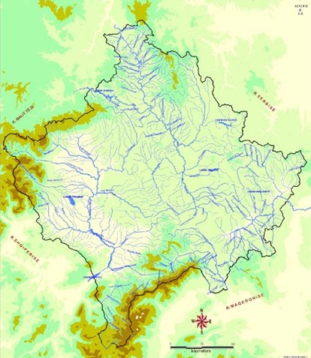
Water resources in Kosovo*
Water management
1. Regional Water Company “Priština”, Priština
2. Regional Water Company “Hidroregjioni Jugor” Prizren
3. Regional Water Company “Hidrodrini”, Peć
4. Regional Water Company “Mitrovica”, Kosovska Mitrovica
5. Regional Water Company “Radonić”, Đakovica
6. Regional Water Company “Hidromorava”, Gnjilane
7. Regional Water Company “Bifurkacioni”, Urosševac
Strengthening of master curricula in water resources management
for the Western Balkans HEIs and stakeholders
www.swarm.ni.ac.rs

Slide 8
Water resources in Kosovo*
Irrigation
Public company “Vodovod Ibar” in Mitrovica North is responsible for water supply in the municipalities of Mitrovica North and Zvečan. These two municipalities are supplied with water by the Regional Water Company “Mitrovica” through water factory which is located in Šipolje (Municipality of South Mitrovica). Municipalities Zubin Potok and Leposavić have their own water supply systems; Public Utility Company “Ibar” in Zubin Potok and Public Utility Company “24 Novembar” Leposavić.
Regional Irrigation Company Beli Drim
Regional Irrigation Company Radonjić-Metohija
Strengthening of master curricula in water resources management
for the Western Balkans HEIs and stakeholders
www.swarm.ni.ac.rs

Slide 9
Water resources in Kosovo*
Floods
Flood Risk Management Planning in Kosovo* is a process that is at the very beginning.
Properly defined plans for flood risk management do not exist
Preliminary assessments for flood risk are not conducted
For some individual river basins there are flood risk management planning but there is no unique methodology that could be applied to all river basins.
Investment
Investment is focused on regulation of rivers and improvement of water infrastructure especially for water and wastewater services.
total investments in the water sector since 1999 amount to EUR 255.77 million, out of which EUR 189.9 million were donations. According to European Union standards, it is estimated that it will take at least EUR 60 million per year in the next ten years for Kosovo* approximation to these standards.
Strengthening of master curricula in water resources management
for the Western Balkans HEIs and stakeholders
www.swarm.ni.ac.rs

Slide 10
Water resources in Kosovo*
Pollution
Regional Environmental Center (REC) in cooperation with MESP prepared the Water Polluters Cadastre in Kosovo*, where in total 368 water polluters were registered. Out of this number, 266 are collective polluters, whereas 102 are individual polluters.
In the region of the watercourse of the Bardhe River, 154 polluters were identified, 99 are collective polluters and 56 are individual polluters. In the regions of Ibar River, Lepenac and Binačka Morava watercourses, 100 polluters were identified, 75 were collective polluters and 25 individual polluters. The watercourse of Binačka Morava and Lepenac has 24 polluters.
Strengthening of master curricula in water resources management
for the Western Balkans HEIs and stakeholders
www.swarm.ni.ac.rs

Slide 11
Water resources in Kosovo*
Industrial pollution
The main industrial polluters are Kosovo Energy Corporation (KEK), Feronikl (production of nickel alloys and iron), cement factory Sharrcem, as well as the Trepča and Kišnica mining complex. Trepča’s discharge of polluters in the water was estimated at 150 tons/year lead, 300-900 tons/year zinc, 900 tons/ year fluoride, etc. Even though most of Trepča’s mining and metallurgical plants are out of operation, acids, dust particles, unsecured operation and poorly maintained and unstable tailing ponds represent a daily danger to those living nearby.
Strengthening of master curricula in water resources management
for the Western Balkans HEIs and stakeholders
www.swarm.ni.ac.rs

Slide 12
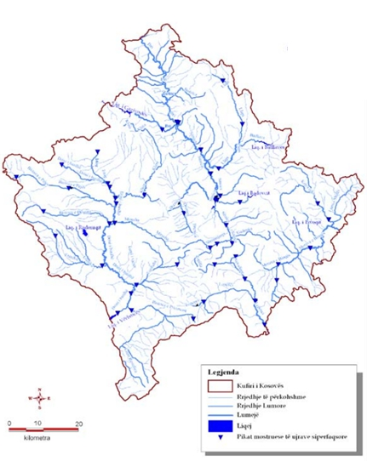
Water resources in Kosovo*
Monitoring
The main industrial polluters are
Up to the end of 2015 the existing hydrometric network was expanded up to 27 stations as depicted on map 5.1. Seven of these stations allow for a real-time data access via GPRS from a central server. Two of these stations as well as the soft- and hardware of the server platform were donated by German GIZ (Gesellschaft fÜr Internationale Zusammenarbeit GmbH) in the context of the “Climate change adaptation in the Western Balkans” project.
Strengthening of master curricula in water resources management
for the Western Balkans HEIs and stakeholders
www.swarm.ni.ac.rs

Slide 13
Legislation in the field of water resources in Kosovo
Law no. 02 / l-79 on hydro-meteorological tasks. It is another important law in the water sector, aimed to regulate meteorological works and the manner of their accomplishment.
Law no. 02/L-78 on public Health. This law stipulates, inter alia, institutions responsible for implementation of health policies, defines the duties of the National Institute of Public Health of Kosovo*, and among other establishes the responsibilities for drinking water quality monitoring
Law Nr. 2004/24 on Kosovo* water
- The purpose of this law is:
• To ensure sustainable development and utilization of water resources, which are necessary for public health, environmental protection and socio-economic development of Kosovo*;
• To establish procedures and guiding principles for optimal allocation of water resources, based on the use and purpose;
• Ensure protection of water resources from pollution, misuse and overuse
• To establish the institutional framework for water resource management
Strengthening of master curricula in water resources management
for the Western Balkans HEIs and stakeholders
www.swarm.ni.ac.rs

Slide 14
Legislation in the field of water resources in Kosovo
Law Nr. 03/L-086 on providers of waste, water, and sewage services-is an important law by which the WWRO is established, and established the legal framework for economic regulation of public companies which provide water and sewerage services; Law on Water no. 04/L-147 The main objectives defined in Article 1 of this Law are protection of water resources from pollution, overuse and misuse, establishment of procedures and guiding principles for the optimal distribution of water resources and determination of the institutional structures for managing the water resources.
Law Nr. 02/L-9 on Irrigation of Agricultural Land. This Law regulates the organization and management of irrigation and drainage of agricultural land in Kosovo*; it defines the powers and responsibilities of the entities for irrigation and drainage. It defines also the establishment and registration of: irrigation companies, associations that use the water for irrigation, federations and their organization, irrigation, water fees, associations’ business and other issues related to irrigation and drainage.
Strengthening of master curricula in water resources management
for the Western Balkans HEIs and stakeholders
www.swarm.ni.ac.rs

Slide 15
Policy
2 Enabling environment for the development, management and use of water resources |  | Not relevant | Under development | Developed but implementation not yet started | Implementation started | Implementation advanced | Fully implemented
I) Main national instruments for water resources management
a. | National water resources policy |  |  |  |  |  | √
b. | Sub-national/provincial/state water resources policy |  |  |  |  | √
c. | National water laws |  |  |  |  |  | √
d. | Sub-national/provincial/state water law | √
e. | National integrated water resources management plan/s or equivalent strategic plan document/s |  |  |  |  |  | √
f. | Separate national water efficiency plan/s | √
g. | Water efficiency in integrated water resources management plan or equivalent | √
II) Other national instruments that may incorporate water resources management
a. | Integrated national policy/strategy/plan for land and water resources management |  |  |  | √
b. | Poverty Reduction Strategy (PRS) with water resources management component |  |  |  |  | √
c. | National Strategy for Sustainable Development |  |  |  |  |  | √
d. | National Development Plan with water resources management component | √
e. | National Environmental Action Plan water resources management component |  |  |  |  | √
f. | National climate change adaptation policy/strategy/plan with water resources management component |  | √
g. | National Agricultural Plan with water resources management component |  |  |  |  |  | √
h. | National energy policy/strategy/plan with water resources management component |  |  | √
i. | National desertification policy/strategy/plan with water resources management component |  |  | √
j. | National wetland policy/strategy/plan with water resources management component |  |  |  | √
k. | National biodiversity policy/strategy/plan with water resources management component | √
III) International agreements on water resources management to which your country is party
a. | Regional/sub-regional water resources management agreements |  |  |  |  |  | √
b. | Transboundary water resources management agreements for specific river basins |  |  |  |  |  | √
Strengthening of master curricula in water resources management
for the Western Balkans HEIs and stakeholders
www.swarm.ni.ac.rs

Slide 16
Issues
• Water permits
• Structure of water charges
• Water infrastructure
• Testing and implementation of minimum standards for drinking water quality monitoring
• Sanitary inspectors
• Criteria for establishment of water protected areas for drinking water sources
• Allowed limit values for effluent parameters which can be discharged into the water body or public sewage network
Administrative instruction under the drafting procedure are:
• Measures and actions for protection from erosion
• Use and maintenance of dams
• Water information system
• Content of the strategic plan for water resources management.
• Water protocol
Strengthening of master curricula in water resources management
for the Western Balkans HEIs and stakeholders
www.swarm.ni.ac.rs

Slide 17
Governance and institutional Framework
3 Governance systems for the development, management and use of water resources |  | Not relevant | Under development | Developed but implementation not yet started | Implementation started | Implementation advanced | Fully implemented
I) Institutional frameworks
a. | Mechanisms (e.g. commissions, councils) for river basin management |  |  |  |  |  | √
b. | Mechanisms for management of groundwater | √
c. | Mechanisms for management of lakes |  |  |  | √
d. | Mechanisms for cross-sector management of water resources | √
e. | Mechanisms for transboundary water resources management |  |  |  |  |  | √
f. | Decentralized structures for water resources management (other than above) |  |  |  | √
II) Stakeholder participation
a. | Stakeholder have access to information on national water resources management and development |  |  | √
b. | Public awareness campaigns on water resources management and development |  |  |  | √
c. | Involvement of general public, civil society organizations and non-government organizations in water resources management and development at the national level |  |  |  | √
d. | Involvement of the private sector in water resources management and development at the national level | √
e. | Involvement of general public, civil society organizations and non-government organizations in water resources management and development at the basin level |  |  |  | √
f. | Involvement of the private sector in water resources management and development at the basin level | √
g. | Gender mainstreaming in water resources management and development |  |  |  |  |  | √
III) Capacity building
a. | Assessment of capacity needs in water resources management at national level |  |  |  | √
b. | Assessment of capacity needs in water resources management at sub-national level |  |  | √
c. | Programs for capacity needs in water resources management institutions/organizations at national level | √
d. | Programs for capacity development in water resources management institutions/organizations at sub-national level | √
e. | Programs for in-service training of staff/professionals in water resources management | √
f. | Water resources management in the technical/higher education curriculum | √
g. | Research programs in water resources management |  |  |  | √
Strengthening of master curricula in water resources management
for the Western Balkans HEIs and stakeholders
www.swarm.ni.ac.rs

Slide 18
Governance and institutional Framework
3 Governance systems for the development, management and use of water resources |  | Not relevant | Under development | Developed but implementation not yet started | Implementation started | Implementation advanced | Fully implemented
I) Institutional frameworks
a. | Mechanisms (e.g. commissions, councils) for river basin management |  |  |  |  |  | √
b. | Mechanisms for management of groundwater | √
c. | Mechanisms for management of lakes |  |  |  | √
d. | Mechanisms for cross-sector management of water resources | √
e. | Mechanisms for transboundary water resources management |  |  |  |  |  | √
f. | Decentralized structures for water resources management (other than above) |  |  |  | √
II) Stakeholder participation
a. | Stakeholder have access to information on national water resources management and development |  |  | √
b. | Public awareness campaigns on water resources management and development |  |  |  | √
c. | Involvement of general public, civil society organizations and non-government organizations in water resources management and development at the national level |  |  |  | √
d. | Involvement of the private sector in water resources management and development at the national level | √
e. | Involvement of general public, civil society organizations and non-government organizations in water resources management and development at the basin level |  |  |  | √
f. | Involvement of the private sector in water resources management and development at the basin level | √
g. | Gender mainstreaming in water resources management and development |  |  |  |  |  | √
III) Capacity building
a. | Assessment of capacity needs in water resources management at national level |  |  |  | √
b. | Assessment of capacity needs in water resources management at sub-national level |  |  | √
c. | Programs for capacity needs in water resources management institutions/organizations at national level | √
d. | Programs for capacity development in water resources management institutions/organizations at sub-national level | √
e. | Programs for in-service training of staff/professionals in water resources management | √
f. | Water resources management in the technical/higher education curriculum | √
g. | Research programs in water resources management |  |  |  | √
Strengthening of master curricula in water resources management
for the Western Balkans HEIs and stakeholders
www.swarm.ni.ac.rs

Slide 19
Management instruments
4 Management instruments for the development, management and use of water resources |  | Not relevant | Under development | Developed but implementation not yet started | Implementation started | Implementation advanced | Fully implemented
I) Water resources development
a. | Basin studies for long-term development and management of water resources |  |  |  |  |  | √
b. | Periodical assessment of water resources |  |  |  |  |  | √
c. | Regulatory norms and guidelines for sustainable development of water resources |  |  |  |  | √
d. | Programs to value water-related or dependent ecosystem services |  |  |  | √
II) Water resources management programs
a. | Groundwater management program |  |  |  | √
b. | Surface management program |  |  |  |  | √
c. | Linked ground and surface water management program | √
d. | Programs for efficient allocation of water resources among competing uses | √
e. | Land/natural resources management programs that include water resources management components | √
f. | Programs for allocating water resources that include environmental considerations | √
g. | Demand management measures to improve water use efficiency in all sectors | √
h. | Program for re-use or recycling of water | √
i. | Programs to evaluate environmental impacts of water projects |  |  |  |  | √
j. | Programs to address water-related disasters (e.g. floods and droughts) |  |  | √
k. | Programs to address climate change adaptation through water resources management |  |  | √
l. | Cooperative programs managing transboundary water resources |  |  |  |  |  | √
m | Programs to reverse environmental/ecosystem degradation |  |  |  |  |  | √
III) Monitoring and information management
a. | Government responsibility for hydro-meteorological monitoring adequately addressed in national legislation |  |  |  |  |  | √
b. | Monitoring of surface water quantity |  |  |  |  |  | √
c. | Monitoring of ground water quantity |  |  |  |  |  | √
d. | Monitoring of water quality |  |  |  |  |  | √
e. | Monitoring of aquatic ecosystems | √
f. | Monitoring of water use | √
g. | Monitoring of water use efficiency | √
h. | Water resources information system |  |  |  |  | √
i. | Forecasting and early warning systems |  |  |  |  | √
IV) Knowledge Sharing
a. | Programs for information exchange and knowledge sharing of good practices | √
b. | Programs for providing advisory (extension) services on water management issues to end users | √
c. | Programs for transferring improved and cost effective water saving technologies | √
d. | Mechanisms for exchanging information between countries | √
V) Financing of water resources management
a. | Cost recovery mechanisms/progressive staff structures for all water uses | √
b. | Subsidies for promoting water efficiency | √
c. | Charges for water resources management (e.g. pollution charges) |  |  |  |  |  | √
Strengthening of master curricula in water resources management
for the Western Balkans HEIs and stakeholders
www.swarm.ni.ac.rs

Slide 20
Infrastructure Development and Financing
5 Infrastructure development for the development, management and use of water resources |  | Not relevant | Under development | Developed but implementation not yet started | Implementation started | Implementation advanced | Fully implemented
I) Investment plans and programs
a. | Water resources included in national infrastructure investment plans |  |  |  |  | √
b. | Irrigation |  |  |  |  | √
c. | Energy/hydropower |  |  |  |  |  | √
d. | Groundwater (e.g. boreholes, pumps and treatment) | √
e. | Flood management |  |  |  |  |  | √
f. | Water supply (domestic and industrial) |  |  |  |  |  | √
g. | Wastewater treatment |  |  |  |  | √
h. | Desalination of seawater | √
i. | Rainwater harvesting | √
j. | Natural systems (e.g. wetlands, floodplains and catchment restoration) |  |  | √
II) Mobilizing financing for water resources infrastructure
a. | Financing for water resources included in national investment plans |  |  |  |  |  | √
b. | Financing for irrigation |  |  |  |  |  | √
c. | Financing for energy/hydropower |  |  |  |  |  | √
d. | Financing for groundwater (e.g. boreholes, pumps and treatment) | √
e. | Financing for flood management |  |  |  |  |  | √
f. | Financing for water supply (domestic and industrial) |  |  |  |  |  | √
g. | Financing for wastewater treatment |  |  |  |  | √
h. | Financing for desalination of seawater | √
i. | Financing for rainwater harvesting | √
j. | Financing for natural systems (e.g. wetlands, floodplains and catchment restoration) |  | √
Strengthening of master curricula in water resources management
for the Western Balkans HEIs and stakeholders
www.swarm.ni.ac.rs

Slide 21
Sources of Financing for the Development of Water Resources
6 Sources of financing for the development of water resources |  | Data not available or not recorded | Not funding allocations made | Declining trend over last 20 years | Increasing trend over last 20 years | Highly variable and no clear trends
a. | Government budget allocation (as % of GDP) for water resources development |  |  |  | √
b. | Grants and loans from aid agencies for water resources development |  |  |  |  | √
c. | Investments from International Financing Institutions (e.g. World Bank) for water resources development |  |  |  |  | √
d. | Investments from private sources (e.g. banks and private operators, non-profit) for water resources development | √
e. | Revenues (e.g. from water use charges/tariffs) used for water resources development |  |  |  |  | √
f. | Payments for ecosystem services and related benefit/cost transfer schemes | √
Strengthening of master curricula in water resources management
for the Western Balkans HEIs and stakeholders
www.swarm.ni.ac.rs

Slide 22
Outcomes and Impacts
7 Improved Water Resources Management |  | Economic* development objectives impact in past 20 years | Social** development objectives impact in past 20 years | Environmental*** objectives impact in past 20 years | Overall national development impact in past 20 years
 |  | 1-5 low to high | 1-5 low to high | 1-5 low to high | 1-5 low to high
a. | Improved policy, strategic planning and legal frameworks | 2 | 2 | 4 | 3
b. | Improved governance and institutional frameworks | 2 | 3 | 3 | 3
c. | Improved management instruments | 1 | 2 | 3 | 2
d. | Improved infrastructure development | 3 | 2 | 3 | 3
Strengthening of master curricula in water resources management
for the Western Balkans HEIs and stakeholders
www.swarm.ni.ac.rs

Slide 23
Priority Challenges
8A Priority water resources challenge areas |  | Current challenge level
 |  | Not a Problem | Low Priority | Medium Priority | High Priority | Highest Priority
I) Water uses
a. | Water for agriculture |  |  |  | √
b. | Water for domestic use |  |  |  |  | √
c. | Water for industry |  |  | √
d. | Water for energy |  |  | √
e. | Water for ecosystems/environment |  |  | √
f. | Water for growing cities |  |  |  |  | √
II) Threats to the resource
a. | Floods |  |  | √
b. | Droughts |  |  | √
c. | Water scarcity (surface water) |  |  | √
d. | Water scarcity (groundwater) |  |  |  | √
e. | Water quality (surface water) |  |  | √
f. | Water quality (groundwater) |  |  |  | √
Strengthening of master curricula in water resources management
for the Western Balkans HEIs and stakeholders
www.swarm.ni.ac.rs

Slide 24
Conclusion
Based on data presented in this report, it may be concluded that:
• Kosovo* still has not: a strategic plan for water, water management plan, river basin management plan and flood management plan.
• Database for water is still incomplete and it is an obstacle to adequate planning in the water sector
• It is evident the inappropriate use of water resources and uncontrolled exploitation of gravel from river beds
• There is a lack of investment for construction of sewerage systems and waste water treatment plants
• There is a lack of research institutions and consequently lack of scientific researches in the field of water
• Insufficient cooperation between the responsible institutions in the water sector
• Insufficient cooperation between government institutions, non-governmental organizations and public
• There is no integrated system for surface and ground water monitoring
The situation with drinking water supply is not satisfactory as a result of the following factors:
• Low quality maintenance of water infrastructure
• Amortization of water supply and sanitation networks
• Lack of a plan to protect water resources
• Lack of long-term plans to supply drinking water
• Concentration of population in urban areas due to uncontrolled migration
• The powers of regional water companies and local governments not clearly defined
• Illegal connections in water supply and sewerage systems
• Serious damage to the distribution network and maintenance problems
• Low levels of payment for water supply services.
Strengthening of master curricula in water resources management
for the Western Balkans HEIs and stakeholders
www.swarm.ni.ac.rs

